Slide 1
COVID-19 RECOGNITION FROM CHEST X-RAY IMAGES USING DEEP LEARNING
PROJECT DOMAIN: PROJECT GUIDE:
DEEP LEARNING -PYTHON DR.L.JABASHEELA
BATCH NO:A9 PROJECT MEMBERS:
KEERTHANA V-211418104119
LAKSHMIPRIYA B-211418104137
MADHUMITHA CT-211418104142

Slide 2
ABSTRACT
The corona-virus 2019(COVID-19), which first occurs in wuhan city of china in december 2019, spread quickly around the world and became A plague. Due to the regular increase in cases, the number of COVID-19 test kits available in the hospital is minimal.
Since an automated detection system is needed as an alternative diagnosis to prevent covid-19 from spreading among people. It is necessary to detect the positive cases as early as possible so as to prevent the further spread of this disease.
Application of convolutional neural networks (cnn) techniques coupled with medical imaging can be helpful for the accurate detection of this disease. In this project A new model for automated COVID-19 detection using raw chest x-ray images is used.
The model is developed to supply accurate diagnosis for binary classification (covid vs. No-findings). We introduced convolutional layers and implemented different filtering on each layer

Slide 3
PROBLEM DEFINITION
In existing system, they use several types of tests like swab test, nasal aspirate and sputum test.
These methods are old one and it takes more number of processes and takes one or two days to predict the covid-19 results.
In emergency situation, this process are little slow to predict.

Slide 4
PROPOSED SYSTEM
The covid-19 pandemic has consumed the world, with 192 countries affected and global cases nearing 150 million.
To overcome the fallback in the existing system we propose a deep learning based system to increase the speed and accuracy.
We have proposed an automatic prediction of covid-19 using a convolutional neural networks and chest x-ray images. Chest x-ray is the best tool for the detection of covid-19.

Slide 5
SOFTWARE REQUIREMENTS
OPERATING SYSTEM : WINDOWS 10 (64 BIT)
SOFTWARE : PYTHON 3.7
TOOLS : ANACONDA (JUPYTER NOTE BOOK IDE)

Slide 6
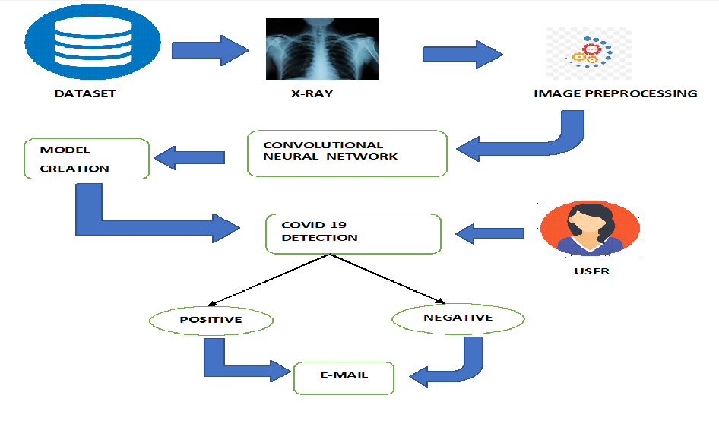
SYSTEM ARCHITECTURE

Slide 7
LITERATURE SURVEY
TITLE OF THE PAPER 1: A modified deep convolutional neural network for detecting covid-19 and pneumonia from chest x-ray images based on the concatenation of xception and resnet.
AUTHOR: Mohammad rahimzadeh , Abolfazl attar
YEAR:2020
JOURNAL NAME: Elsevier[informatics in medicine unlocked]
METHODOLOGY:
In this paper they have trained several deep convolutional networks with introduced training techniques for classifying x-ray images into three classes: normal, pneumonia, and covid-19.
The two open source datasets used in this paper are kaggle(14,8633 images) and github(222 images).
They proposed a neural network which is a concatenation of the Xception and Resnet network.
This network achieved the best accuracy by utilizing multiple features extracted by two robust networks.
The network is trained for about 8 consecutive phases.
OBSERVATION:
They had an unbalanced dataset and a few cases of covid-19, by using the proposed technique, we could have improved covid-19 detection along with the other classes detection.
The accuracy rate of this project is high and will be helpful in future medical diagnosis.
It reduces the false covid 19 detections.

Slide 8
TITLE OF THE PAPER 2: COVIDGR Dataset and COVID-SDNet Methodology for Predicting COVID-19 based on Chest X-Ray Images.
AUTHOR:S. Tabik , A. Gómez-Ríos, J. L. Martín-Rodríguez, I. Sevillano-García, M. Rey-Area, D. Charte, E. Guirado, J. L. Suárez, J. Luengo, M. A. Valero-González, P. García-Villanova, E. Olmedo-Sánchez, and F. Herrera.
YEAR:2020
JOURNAL NAME: IEEE Journal of biomedical and health informatics
METHODOLOGY:
The dataset named COVIDGR was built which contains 426 positive and 426 negative PA CXR views.
The algorithm used here is CNN.
They proposed COVID Smart Data based Network (COVID-SDNet) methodology which improves the generalization capacity of COVID-classification models.
The output results based on the severity levels i.e, normal,mild stage, moderate stage, severe stage.
OBSERVATIONS:
The COVID-SDNet can be used in a triage system to detect especially moderate and severe patients.

Slide 9
TITLE OF THE PAPER 3: Detection of COVID-19 from chest x-ray images using convolutional neural networks
AUTHOR: Boran sekeroglu and Ilker Ozsahin
YEAR: 2020
JOURNAL NAME: Original research
METHODOLOGY:
A total of 225 COVID-19 chest x-ray images were obtained from cohen. And it comprised 131 male patients and 64 female patients.
The dataset used in this study does not have accompanying complete metadata, because this is the very first publicly available COVID-19 x-ray image collection, and it was created in a limited time. Several categorized experiments were performed to evaluate the efficiency of the convnet on the considered image.
Experiments were divided into three categories: convnet experiments, statistical measurement experiments, and transfer learning experiments.
OBSERVATION:
The performed experiments should be analyzed separately to evaluate the performance of the applied techniques and considered models. The final evaluation process was performed by the eightfold cross-validation method and ROC AUC score because of the imbalanced database.
Detection of covid-19 from chest x-ray images is of vital importance for both doctors and patients to decrease the diagnostic time and reduce financial costs.

Slide 10
TITLE OF THE PAPER 4 : Covid-19 Detection from Chest X-Ray using Convolution Neural Networks
AUTHOR: Pillalamarry Mahesh, Yakkala Gnana Prathyusha, Botlagunta Sahithi, S Nagendram
YEAR:2020
JOURNAL NAME: Journal of Physics: Conference Series
METHODOLOGY:
There are different ways to diagnose the COVID-19, but they are cost-effective and increasing the time taken to produce, buy using chest x-ray we can reduce cost and result in Time.
But to diagnose x-ray’s we need expert radiotherapists. Thus, we developed a model that automatically detect COVID and non-COVID X-rays. These days Deep Learning algorithms showing the foremost results in Disease classification. Also, features learned by pre-trained Convolution Neural Networks (CNN) models on large-scale datasets are much useful in image classification tasks.
we train and test our model to analyze the images as COVID or normal. We analytically determine the optimal CNN model for the purpose. The accuracy metrics are used to validate the classification of the model.
OBSERVATION:
In this model, a study was conducted and presented how Convolutional Neural Networks (CNN’s) shows top results in the detection of COVID images.
Research findings indicated that Convolutional Neural Networks have the latent to detect respiratory diseases with the best accuracy, although a large amount images are needed, achieves an accuracy of 95% train accuracy and 98% of validation accuracy. By improving the networks, we can achieve 100% accuracy.

Slide 11
TITLE OF THE PAPER 5: Specialized covid-19 detection techniques with machine learning
AUTHOR:Parag Chatterjee , Mainak Biswas, and Arnab Kumar Das.
YEAR:2020
JOURNAL NAME: Journal of Physics
METHODOLOGY:
The convolutional neural network architectures used for the study in this paper were VGG19,MobileNet v2, Inception, Xception, Inception ResNet v2.A parameter called layer cut-off was defined after several experiments which are defined as the number of un-trainable layers beginning from the bottom of CNN.
It uses the technique called transfer learning for automatic detection of the COVID-19 disease. The advantages of transfer learning is that it provides better results for detection of abnormalities in medical image datasets
OBSERVATION:
AI-based solutions can be used to simultaneously analyze multiple input Computed Tomography (CT) images of the chest may lead to early detection of the disease efficiently.
Convolutional neural networks can also be used accurately for COVID-19 classification from X-ray images.

Slide 12
TITLE OF THE PAPER 6 : COVID-19 Prediction and Detection Using Deep Learning
AUTHOR: Moutaz Alazab, Albara Awajan, Abdelwadood Mesleh, Ajith Abraham, Vansh Jatana, Salah Alhyari
YEAR: 2020
JOURNAL NAME: International Journal of Computer Information Systems and Industrial Management Applications.
METHODOLOGY:
Three forecasting methods—the prophet algorithm(PA), autoregressive integrated moving average (ARIMA) model and long short-term memory neural network (LSTM) were adopted to predict the numbers of COVID-19 confirmations.
CNN-based COVID-19 detector delivered superior performance in terms of precision, recall, and F-measure.
COVID-19 detector obtained better results when using augmentation. A better training process was achieved as the gap between the training and validation became smaller.
Thus, the COVID-19 detector trained on augmented data provides superior performance metrics and is robust for diagnosing COVID-19 in chest X-ray images.
OBSERVATION:
Prophet algorithm (PA) delivered the best performance. It predicted the number of COVID-19 confirmations, recoveries, and deaths in Australia and Jordan and obtained prediction accuracies.
The diagnosis model allows the rapid and reliable detection of COVID-19, enabling it to achieve an F-measure of 99% using an augmented dataset.

Slide 13
TITLE OF THE PAPER 7: Deep learning for COVID‐19 detection based on CT images.
AUTHOR:Wentao Zhao, Wei Jiang & Xinguo Qiu.
YEAR:2021
JOURNAL NAME: Scientifc Reports.
METHODOLOGY:
CT images has been proposed as an essential substitute tool for COVID-19 detection.
Here the CT images of patients are collected from China National Center for Bioinformation (CNCB) and COVIDNet-CT repository from github.
They used transfer learning method to improve the performance of CNN on covid 19 testing using CT images.
The Grad-Cam visualization techniques is established to explore and understand the covid affected area in the CT image.
OBSERVATION:
Most of the CT images used for diagnostic purposes are not openly accessible.
Due to the absence of open-source datasets on COVID-19 CT images , the development of more advanced artifcial intelligence technologies for better detection of CT on COVID-19 cannot be achieved.

Slide 14
TITLE OF THE PAPER 8: COVID-19 detection based on lung ct scan using deep
Learning techniques
AUTHOR: S. V. Kogilavani , J. Prabhu,R. Sandhiya,M. Sandeep Kumar,UmaShankar Subramaniam, Alagar Karthick,M. Muhibbullah and Sharmila Banu Sheik Imam
YEAR: 2021
JOURNAL NAME: Hindawi [computational and mathematical methods in medicine].
METHODOLOGY:
A deep learning method, CNN takes an input image and assigns weight to various objects in the picture, allowing it to differentiate between them
Deep learning architectures, namely,VGG16, DenseNet , MobileNet , Xception , Efficient Net and NASNet are used to classify the data. Each model has been trained for a total of 50 epochs. Chest tomography CT scan images are given as the input.
The image filtering preprocessing technique is used to filter the size of all input samples.There are several methods to evaluate a model’s performance. Accuracy, precision, recall and F-score are the measures considered to estimate
chest CT scan images
OBSERVATION:
VGG16 gives better results as the number of parameters trained in VGG16 is less, and it takes less time to train the samples. So, it is better than other CNN models.
Increasing the number of epochs, on the other hand, improves the model’s accuracy.
The limitation of the proposed work is that it does not identify COVID-affected areas in the lungs.

Slide 15
TITLE OF THE PAPER 9: Design of Accurate Classification of COVID-19 Disease in X-Ray Images Using Deep Learning Approach
AUTHOR: Joy Iong-Zong Chen
YEAR:2021
JOURNAL NAME: Journal of ISMAC
METHODOLOGY:
This research work has created an accurate classification method for performing a reliable detection of COVID-19 viral patterns using x-ray and the Histogram-Oriented Gradients (HOG) methodology.
The analysis of 10 fold cross-validation with confusion metrics can also take place in our research work to detect various diseases caused due to lung infection such as Pneumonia corona virus positive or negative.
CNN is a deep learning algorithm, which can be implemented in the processing of the medical image to support a proper and fast decision-making. The training by CNN is then used to interpret new medicinal images through the recognition of patterns.
OBSERVATION:
The proposed CNN method shows good detection accuracy in a fast and effective manner.
The study has also used limited datasets from various sources in order to analyze the robustness of the systems by responding to real-world scenarios.

Slide 16
TITLE OF THE PAPER 10 :COVID-19 Detection Empowered with Machine Learning and Deep Learning Techniques: A Systematic Review
AUTHOR: Amir Rehman, Muhammad Azhar Iqbal, Huanlai Xing and Irfan Ahmed
YEAR: 2021
JOURNAL NAME: Applied sciences
METHODOLOGY:
Here the study reveals that ML/DL technique accuracy lay between 80% to 100% when detecting COVID-19. The RT-PCR-based model with Support Vector Machine (SVM) exhibited the lowest accuracy (80%), whereas the X-ray-based
model achieved the highest accuracy (99.7%) using a deep convolutional neural network.
It can be stated that radiological X-ray image-based models worked better than the C.T. image-based models.
OBSERVATION:
ML and DL techniques played a significant role in the prediction, classification, screening, and minimizing the spread of the COVID-19 pandemic.
Various kinds of diagnosis and detection strategies have been developed to control the spread of COVID-19 based pandemic, but the knowledge related to the applications of various ML/DL techniques to detect the virus is still insufficient.
To solve the issue, researchers need to work on appropriate ML/DL techniques that can provide better results using small datasets

Slide 17
FEASIBILITY STUDY
TECHNICAL FEASIBILITY
Deep learning techniques can help in determining COVID-19 virus with Chest X-ray Images.
Due to the high availability of large-scale annotated image datasets, great success has been achieved using convolutional neural network for image analysis and classification.
We use deep learning with python as it solves complex problems and also it is platform independent.
ECONOMIC FEASIBILITY
As the COVID-19 spread progresses throughout remote and economically challenged locations an ability to diagnose COVID-19 from a readily available chest X-RAY image would help slow the spread of the disease and result in a better medical outcome for the population. Thus our project is economically feasible.
SOCIAL FEASIBILITY
Fast and timely detection of COVID positive patients is necessary to avoid spreading the disease and keeping it in control.
This project has been done to detect the COVID positive patients from Chest X-Ray images in a simple and inexpensive way.
As our project is inexpensive and it is user-friendly, it is socially feasible.

